Slide 1
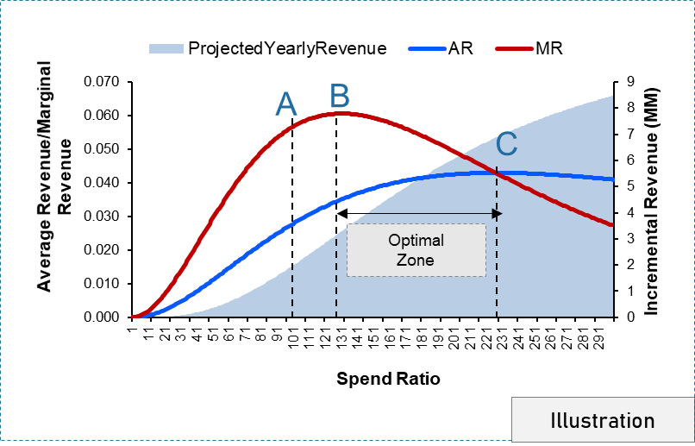
Upcoming Deliverables – Response Curves
Response curve is a mechanism identifying how your Response (Incr. Revenue Per Impression) moves along with additional Impressions. It helps you explain what the optimal level of Impressions is to attain the maximum volume response and what is your saturation point.
Point A: Current Threshold- This is the minimum amount of Impressions that is currently used by the media tactics.
Point B: Maximum Marginal - At this point, the maximum volume response per one Impression is reached. Marginal Digital media response is maximized i.e. the rate of increase after this point will not be the same as you increase the amount of Impressions
Point C: Maximum ROI- At this point, the best returns are obtained for the level of investment.
Optimal Range :
Between point B and C- After point B, marginal Digital media response per Impression declines; however, cumulative volume per cumulative Impressions (Digital media
responsiveness) are still rising which causes ROI to rise. After point C, Digital media response and ROI diminish.

